Slide 1
Yeezy vs. Off White
Sneaker Resell Value
Kirstie Jones, James Nguyen, Amy Vong, Nicole Zheng

Slide 2
Background
HISTORY
Sneaker collecting is a culture that began in the 1980s with the launch of Nike Air Jordan’s and has since continued to boom and gone global. The trend is especially popular in streetwear and hip-hop culture.
INDUSTRY GROWTH
The sneaker market has really taken off with the growth of online retailers and auction sites. Increased popularity has also meant the emergence of a counterfeit market. In response, sites like StockX and GOAT provide trustworthy platforms for legitimate reselling of authenticated items.

Slide 3
Background: The Designers
Virgil Abloh is an American designer, Artistic Director of Louis Vuitton men’s wear, and CEO for the fashion label Off-White. Off-White is an Milan based fashion company founded by Abloh, with independent designs and collaborations with other brands. In 2017, the company collaborated with Nike and worked on a project named ‘The Ten” which is a sneaker collection featuring different Nike and Converse nineties-styled shoes with various patterns and materials.
Kanye West is an American rapper, producer, and fashion designer. Though prominent in the music industry, West has always made his interest into venturing into the fashion industry known throughout his career. In addition to multiple collaborations and independent designs, West also has a fashion collaboration, Adidas Yeezy, with fashion collaboration between the German sportswear brand Adidas. The collaboration has become notable for its high-end sneakers, and the Yeezy Boost sneaker line has been considered one of the most influential sneaker brands in the world.

Slide 4
What has the biggest effect on resell value?
Hypothesis
Social Media Buzz (Google Trends)
Brand Name
Color way
Size
Geography
Notes:
KJ:
Our proposed questions:
Is there a correlation between social media influence and sneaker resell value?
Is there a correlation between resell value and shoe size?
Is there a correlation between resell value and color way?
Is there a correlation between social impressions and resell value or velocity of buy?

Slide 5
StockX
2019 contest offering prizes for the best visualizations of this dataset
Data contains information on Yeezy & Off White sneakers
Google Trends
Used as proxy for social media buzz in lieu of historic social media API data
We restricted the data to match our StockX timeline (Sept 2017 – Feb 2019)
Data Sources
Notes:
Our starter data came from Stock X. They are a “live/ask bid website” that held a contest last year and offered prizes for the best visualizations of the given data. The data contained information on Yeezy and Off White sneakers including their original sale price, resell value, size, color way, and buyer state from Sept 2017 to February 2019. We used Google Trends as a proxy for social media buzz in lieu of access to historic social media API data.

Slide 6
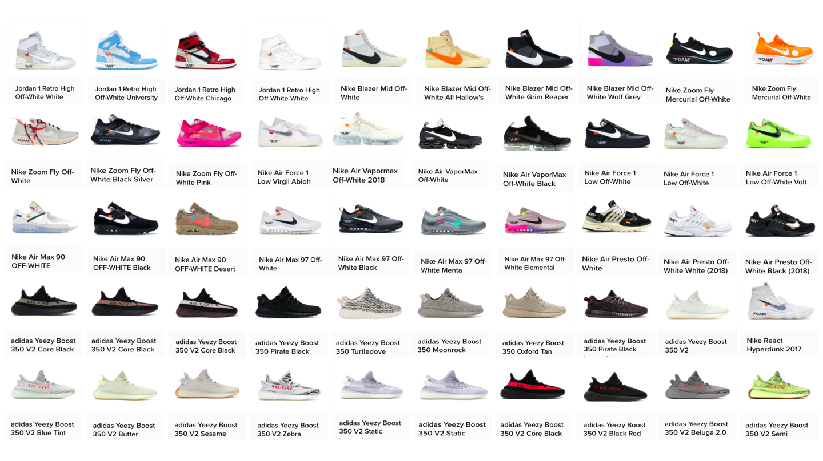
We observed:
11 shoe types
50 different color ways (i.e. colors)
Each color way had different available units, launch dates, & retail pricing
Notes:
KJ: We observed 11 shoe types in 50 color ways. Each color way had different available units, different launch dates, and retail pricing.

Slide 7
Methodologies
Shoe sales data was analyzed along groupings of:
sneaker type (eg. Air Max 90s, Yeezy Boost 350s, Air Force 1s, etc)
sneaker colorway
Brand
geographic buyer distribution
Google Trends data was pulled for brand searches on a state level and national level

Slide 8
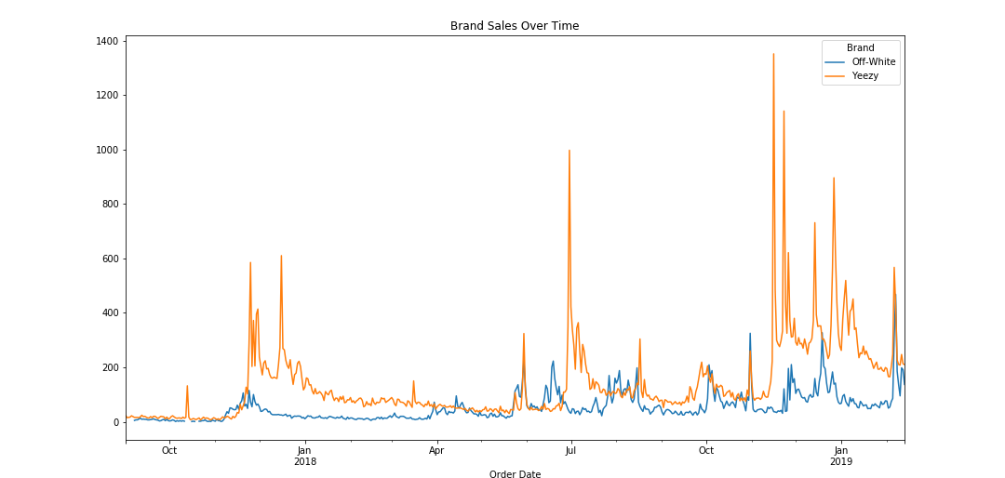
Analysis: Brand Name vs Resell Value
We wanted to analyze sale trends between the 2 brands over time to see if there were any spikes during certain times of year, as well as compare the brand sales ($)
Notes:
KJ: This graph shows a breakdown comparing the 2 brands (Yeezy and Off White) and tracks the sales over time.

Slide 9
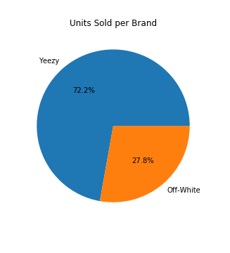
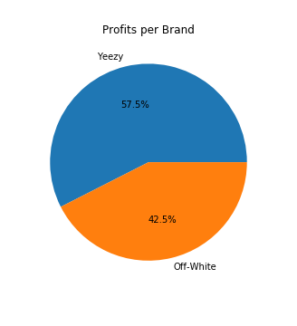
Analysis: Brand Name vs Resell Value
In analyzing the 2 brands, we examined both how many shoes were sold, as well as $ to dig into the popularity and resell worth
We were surprised to find that, although Yeezy sold more units, Off White resells were more profitable
Notes:
KJ: We were surprised to find that even though Yeezy sold more units, Off White resells had more profitability

Slide 10
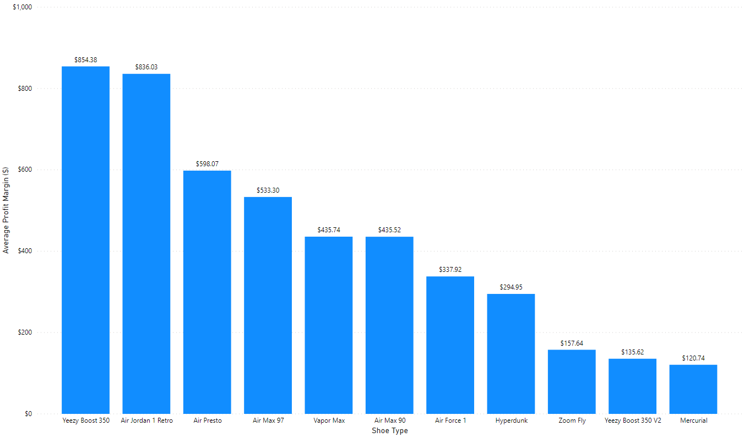
Analysis: Brand Name vs Resell Value
Avg Money Made Reselling
Notes:
AV:

Slide 11
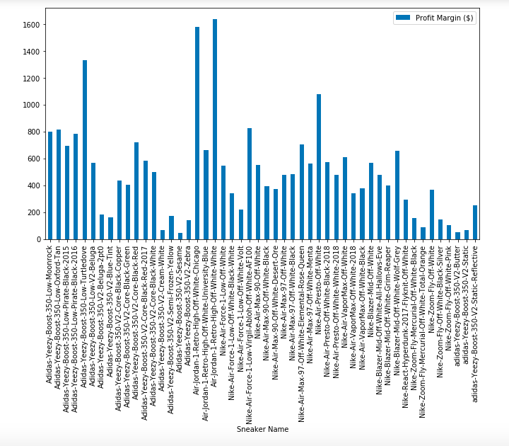
Resell $ By Color Way

Slide 12
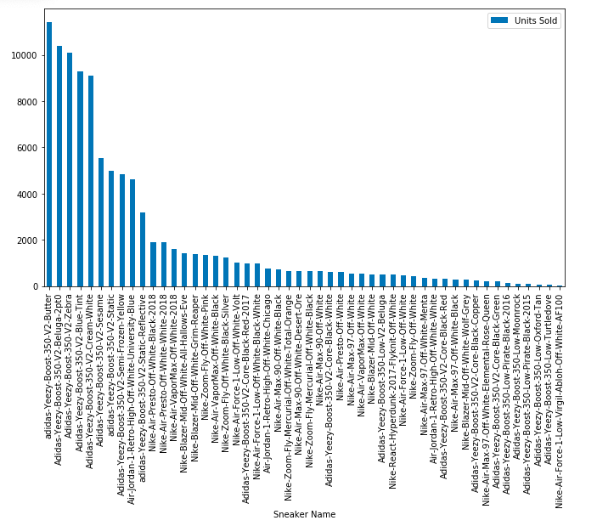
Sneaker Units + Color Way Sold
Notes:
AV:

Slide 13
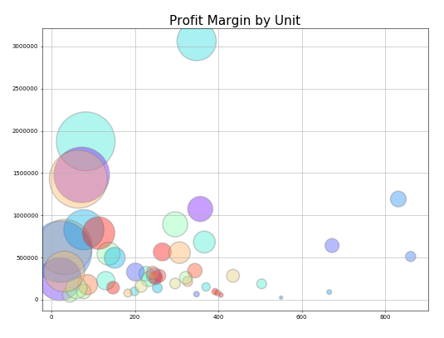
Notes:
AV

Slide 14
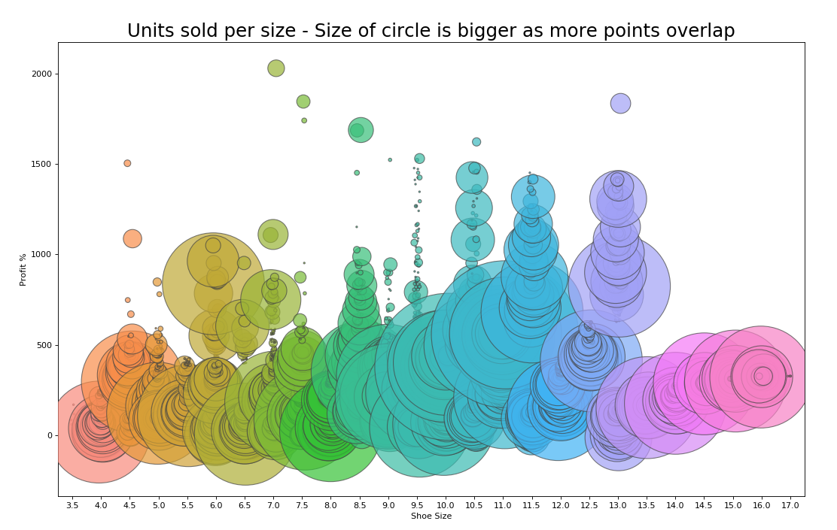
Analysis: Shoe Size vs Resell Value
An examination of all the shoes sold in the dataset shows the bigger the bubble, the more units sold in that size
This reveals the correlation between shoe size & resell value, the most common shoe sizes (9-11) have the highest chance of reselling at a high value
Notes:
KJ: Correlation b/t resell and sizing
Representation all of the shoes sold in the dataset. The bigger circles show that there are more units sold in that size. You can see from this, if you purchase a size 9-11, you stand the highest chance of reselling at a high value.

Slide 15
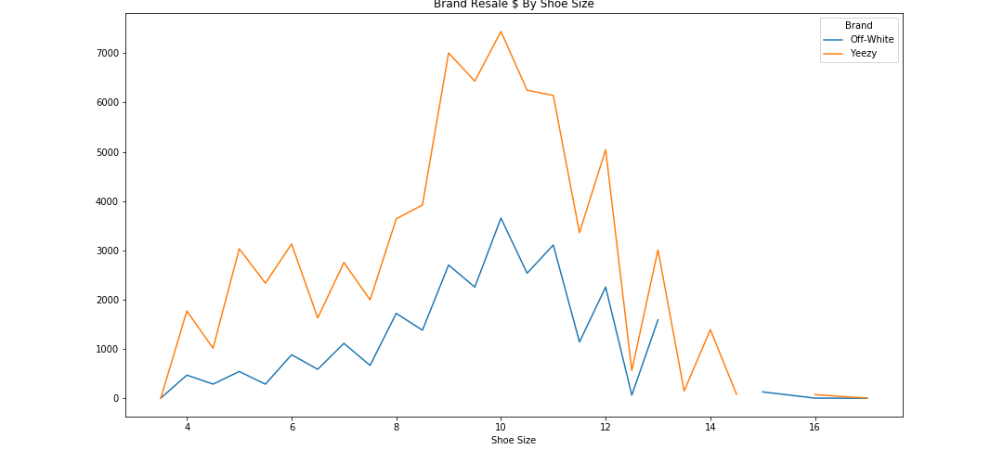
Analysis: Shoe Size vs Resell Value
Breaking down the 2 brands and examining the correlation between shoe size and resell value shows the same spike around the common sizes 9-11
It also reveals that Yeezy is much more dramatic in the difference between the resell value of size 11 vs 14. Off White is more consistent in value across the sizes.
Notes:
KJ: This chart matches the bubble chart above, showing the same spike in shoe size with resell value. And that spike represents how common having size 9-11 shoes is.

Slide 16
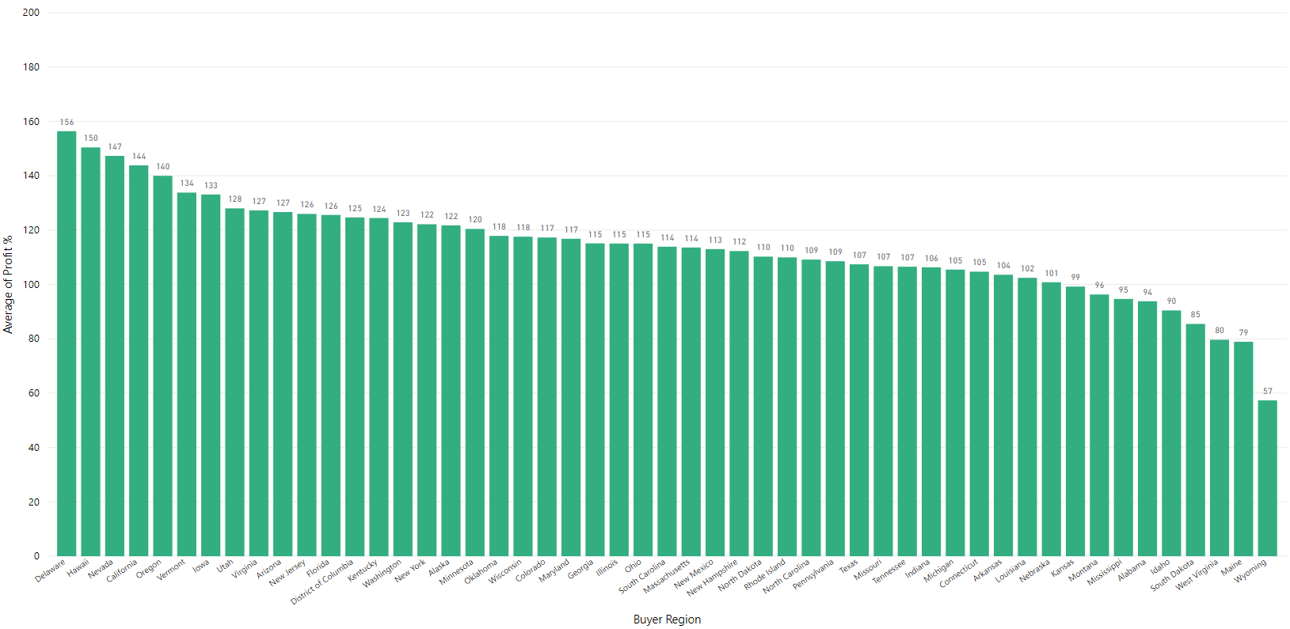
Avg Profit Margin % per State
On average, people made profit no matter what shoe and where it was sold
However, people saw greater margins of profit selling to different geographic areas that lined up with our expectations of observable trends:
Biggest profits were in:
Regions of higher population density
Regions known to be drivers/innovators of sneaker culture
Lowest profits were in areas of lower population density
Notes:
JN

Slide 17
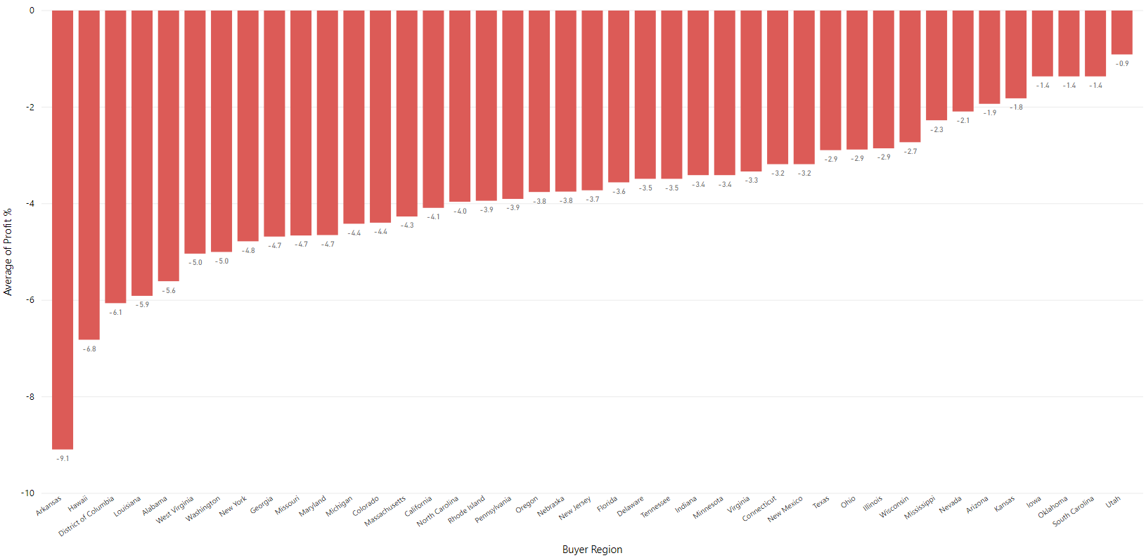
Avg Loss Margin % per State (where applicable)
When looking at the data, there were inevitably going to be people who lost money trying to re-sell
After slicing data for loss margins, only shoe brand that experienced any losses at all were Yeezy Boost 350 V2s
Geographic distribution of losses lined up with our expectations as well
Biggest losses typically in states with higher volume, more competition for resales
High variability in both extremes of high sample size and low sample size states
Despite that, loss margins were on average relatively low
When you win, you win big & when you lose, you lose small
Notes:
JN

Slide 18
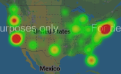
Volume of Dollars Spent in US
Visualizing the volume of dollars spent on sneaker re-sales, we saw 3 major zones of activity:
Eastern Seaboard
California
Oregon
These 3 markets have the biggest volume of sales and the most $ velocity, which reinforces the importance of these markets as cornerstones of sneaker culture AND marketing targets
Notes:
JN: Top 5 states that spend the most money

Slide 19
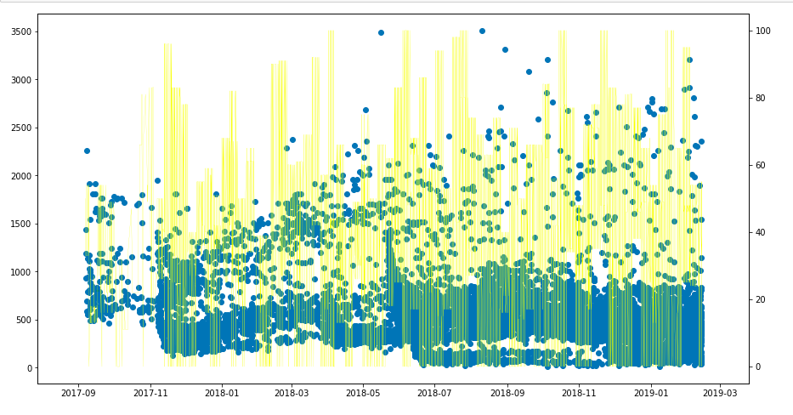
Off White Sales vs Social Media Correlation (Top 5 States)
When charting the Google Trends scores for “off-white” vs sales data, we noticed a slight correlation
Generally, Trend scores remained high overall
Spikes in Trend scores tended to line up with sale price spikes
Notes:
JN

Slide 20
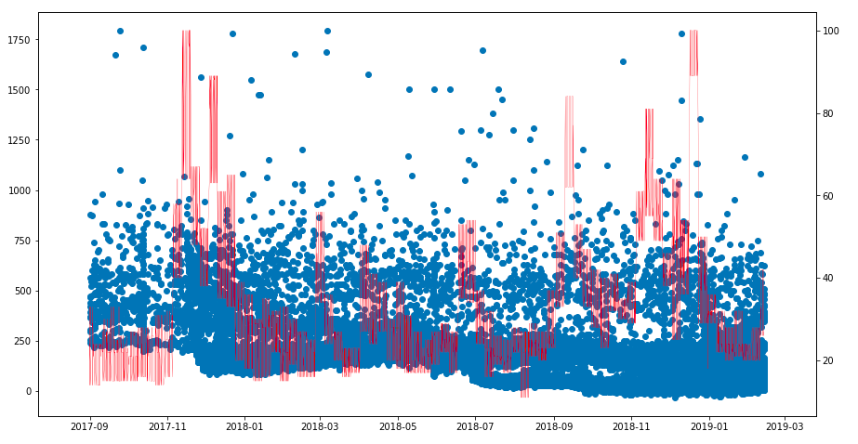
Yeezy Sales by Social Media Correlation (Top 5 States)
When charting the Google Trends scores for “yeezy” vs sales data, we noticed a lesser correlation
Notes:
JN

Slide 21
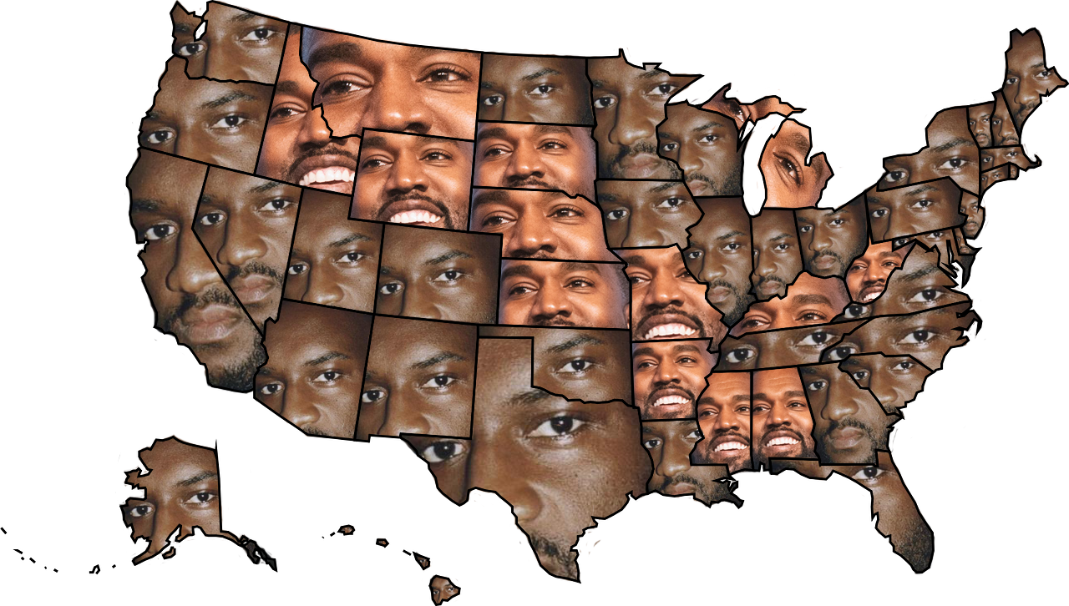
Ye-nited States of Virgil
In the spirit of the upcoming presidential election, we wanted to see who would win the cultural battle for America's Top Designer
People say "Money talks", so we used sales dollars to represent votes
Virgil won a plurality of both number of states and populous states, so Virgil Did It Again™
Notes:
JN: Who sold the most in each state – Off White or Yeezy?

Slide 22
Conclusions

Slide 23
Data Limitations & Other Considerations
Google Trends scores:
Imperfect measure of social media buzz, mostly due to the potential for “signal noise”
“Yeezy” is both a brand name and a nickname for Kanye West himself, so spikes in activity could be due to unrelated reasons to sneakers
“Off-White” is a fairly common color, so data in general could be due to unrelated searches for the color itself rather than the brand
Access to API resources:
An enterprise level API license for true social media scrapes like Twitter or Instagram could bear more fruit for historical trend analysis
Focus searches in an around sneaker release dates or other important news related to the brand
StockX source data:
Only included basic geographic data
Would’ve been interesting to see a deeper analysis based on zip, county data
Only 2 brands, 50 color ways
Analysis of more brands and more types of shoe in the re-sale market

Slide 24
Q&A
Notes:
Since social media mentions doesn’t have a strong correlation to resell value, we have found that size, scarcity, region has a stronger impact on the value the sneaker holds in the market.

